Slide 1
«The Merchant of Venice» (1597) and suspension of disbelief
Silvia Gasparini
Or, Ten Points for a Legal Analysis

Slide 2
The plot--- (Britannica – online Encyclopaedia )
Bassanio, a noble but penniless Venetian, asks his wealthy merchant friend Antonio for a loan so that Bassanio can undertake a journey to woo the heiress Portia. Antonio, whose money is invested in foreign ventures, borrows the sum from Shylock, a Jewish moneylender, on the condition that, if the loan cannot be repaid in time, Antonio will forfeit a pound of flesh. Antonio is reluctant to do business with Shylock, whom he despises for lending money at interest (unlike Antonio himself, who provides the money for Bassanio without any such financial obligation); Antonio considers that lending at interest violates the very spirit of Christianity. Nevertheless, he needs help in order to be able to assist Bassanio. (...)
News arrives that Antonio’s ships have been lost at sea. Unable to collect on his loan, Shylock attempts to use justice to enforce a terrible, murderous revenge on Antonio: he demands his pound of flesh. Part of Shylock’s desire for vengeance is motivated by the way in which the Christians of the play have banded together to enable his daughter Jessica to elope from his house, taking with her a substantial portion of his wealth, in order to become the bride of the Christian Lorenzo. Shylock’s revengeful plan is foiled by Portia, disguised as a lawyer, who turns the tables on Shylock by a legal quibble: he must take flesh only, and Shylock must die if any blood is spilled. Thus, the contract is canceled, and Shylock is ordered to give half of his estate to Antonio, who agrees not to take the money if Shylock converts to Christianity and restores his disinherited daughter to his will. Shylock has little choice but to agree. The play ends with the news that, in fact, some of Antonio’s ships have arrived safely.

Slide 3
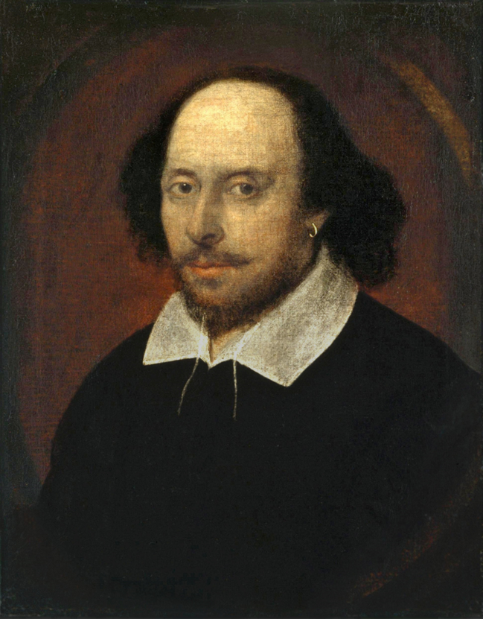
Quite shortly: my opinion about Shakespeare
I believe that Shakespeare’s works were written by Shakespeare himself (not Francis Bacon, Lord Southampton or Queen Elizabeth Tudor…)
My opinion is that Shakespeare is an outstanding author.
I believe that Shakespeare wrote his plays for the box office as much as for his art.
I believe that Shakespeare was perfectly right in giving the stories precedence over realism of detail.
So there is no problem from the point of view of art if most of the legal details in «The Merchant of Venice» are completely made up!
… Let’s go and have a look …

Slide 4
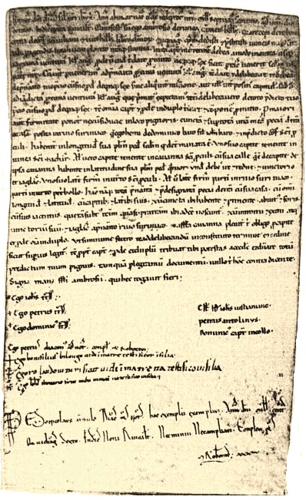
One: the contract
All contracts in Venice were written.
Most Venetians were literate, but legal deeds were written by a notary, who knew how best to write them down clearly.
The Venetian notaries, unlike those practicing elsewhere, were the parish priests; only in the XVI century a turnover began involving secular professionals.
No notary, especially if he was a priest, would ever have assented to a penal clause for the unfulfilled payment of a loan in the form of a pound of human flesh, whether Christian of otherwise!

Slide 5
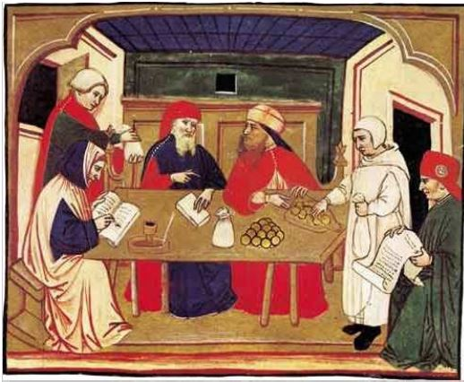
Two: the unfulfilled payment
Shylock gives Antonio a loan for 3000 ducats. Out of pique, he waivers the compensatory interest usually agreed and due in addition to the capital sum.
On the due date, Antonio finds himself impecunious…
(but in Venice it was not only the Jews who loaned money: Antonio could have found someone else to ask money from).
Shylock sues him for the unfulfilled payment and Antonio is apprehended, waiting for the trial…
(but in Venice preventive detention was only applied for crimes, not debts!)

Slide 6
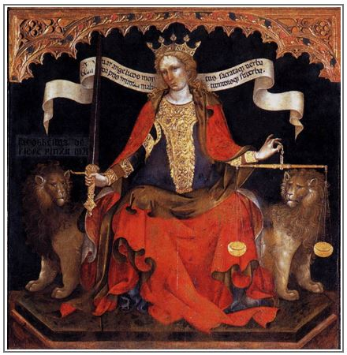
Three: the doge
In «The Merchant of Venice», Shakespeare shows the doge in the position of sole judge, invested with sovereign powers and aiming at applying them according to the law.
In reality, the powers of the doge were strictly limited by the rules written in the ducal oath,to which the newly-elected doge was bound to swear obedience: the doge was not in any sense an absolute sovereign, like the Tudors in England.
The doge never performed as a judge! On the opposite, he was forbidden from influencing the decision of judicial cases.
The Venetian Justice is not blind, but instead very keen-sighted in pondering the long-term effects of the decision…

Slide 7
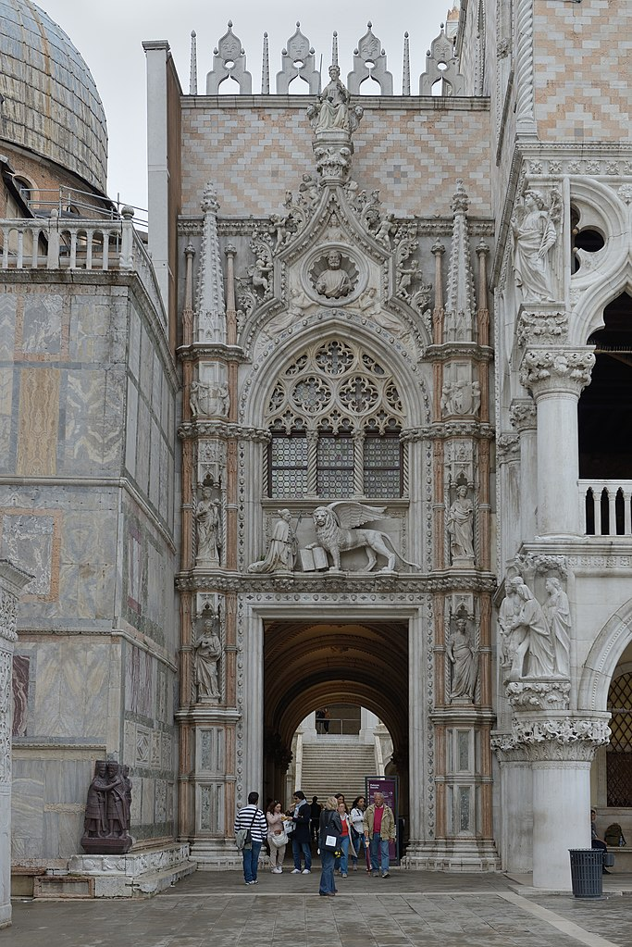
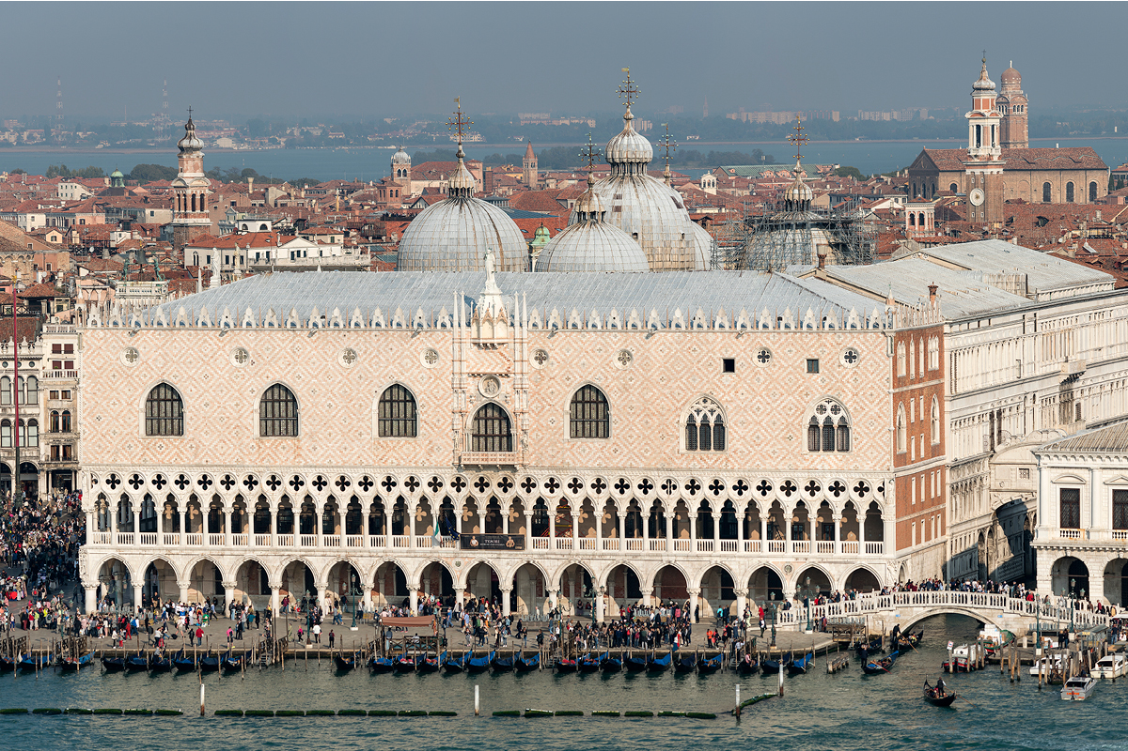
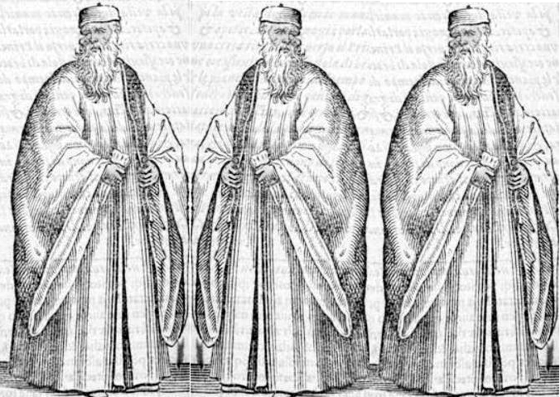
Four: the Court of Justice
The Venetian civil Courts in the first degree of judgment (Corti di Palazzo) were composed of three judges, elected by the Major Council for the term of one year. They were assisted by a secretary.
The Courts operated in the Ducal Palace, off the courtyard entered from the Porta della Carta.

Slide 8
Four, addendum: which of the Courts?
As a foreigner suing a citizen, Shylock would likely present his complaint to the Curia del Forestier.
However, the capitular of Forestier (like those of the other Courts) forbids to decide unless by applying already existing rules… but there is no rule contemplating such a penalty clause as Shylock is demanding!
So the complaint would probably be sent to the Curia di Petizion, instituted in 1244 to relieve the Minor Council from the decision of unregulated cases.
The capitular of Petizion gives the power to solve cases per iustitiam, laudum et arbitrium…
…this means that, whatever the decision may be (arbitrium), it will be the right solution for the case (iustitiam) because the judges deliberated the sentence by vote of majority or unanimity (laudum).
This is the practical reason why the Venetians do not need to resort to the Roman law as a supplementary source of law! (the judges of the Curia si supplement the rules themselves)

Slide 9
Five: the trial
The judges hear the plaintiff Shylock and the defendant Antonio, and they examine the evidence = the deed.
But in Venice each of the parties in a controversy were assisted ex officio by an avvocato ordinario (provided advocate): thia was also an elected, short-term office, charged to make sure that all evidence and arguments in favouor of the party were brought to the judges.
Note: this is *not* the role of Portia/Balthasar, about which soon below..
Once the parties and their advocates had been heard, the judges retired to discuss, propose and vote the decision.
The voted first to decide who was in the right, then separately to decide the contents of the sentence.
The sentence was approved by vote of majority (2 out of 3) or unanimity (3 out of 3).

Slide 10
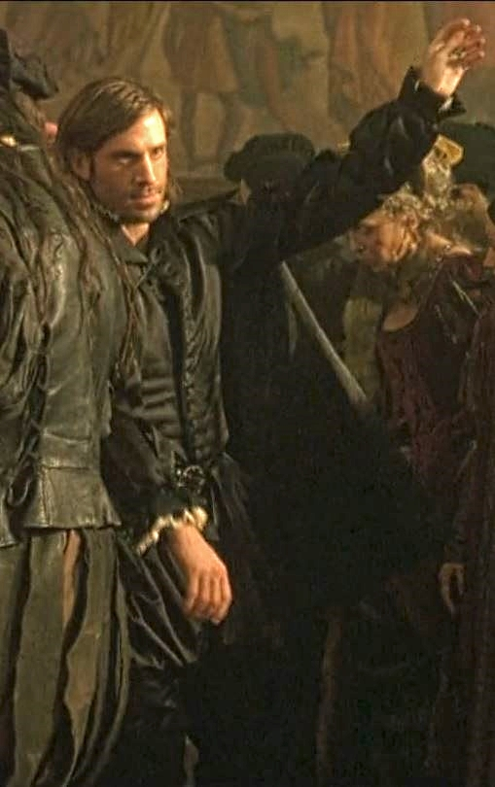
Six: the parties
In front of the judge(s) are present the plaintiff and creditor Shylock and the defendant and debtor Antonio, but also Bassanio…
…and Bassanio shows up in Court with cash in hand, ready to pay the loaned capital, plus any further sum the judge(s) may fix for late payment interests (from the due date to the day of the trial) and Court costs.
Shylock is not allowed to refuse to receive the total sum established by the judge(s) and offered by Bassanio, otherwise he would be a defaulting creditor!
In that case, no further interests for delay would accrue (because from then on Shylock himself will guilty of the prolonged delay), and from the total due by Antonio will be subtracted the expenses incurred by the same in order to secure the sum (e.g. the cost of a deposit care of the judges).

Slide 11
Seven: about Portia/Balthasar
Portia/Balthasar appears in Court as a consultant, not for either of the parties, but for the judge(s).
The Roman law studied in the Universities, of wich Balthasar is a doctor, was commonly applied in Italy when local rules to solve a case were missing. But in Venice it did not! Because of historical reasons, Roman law was never applied in Venice.
Therefore Portia/Balthasar from Rome, but also Bellario from Padua, would never be admitted in Court! Their science is useless in Venice.
Only Venetian rules of law were applied in Venice, that is: -- laws deliberated by Councils and magistrates; -- customs proven existing by the archives of the magistrates, provided they were reasonable… which is not of course the case for the butchering penal clause!

Slide 12
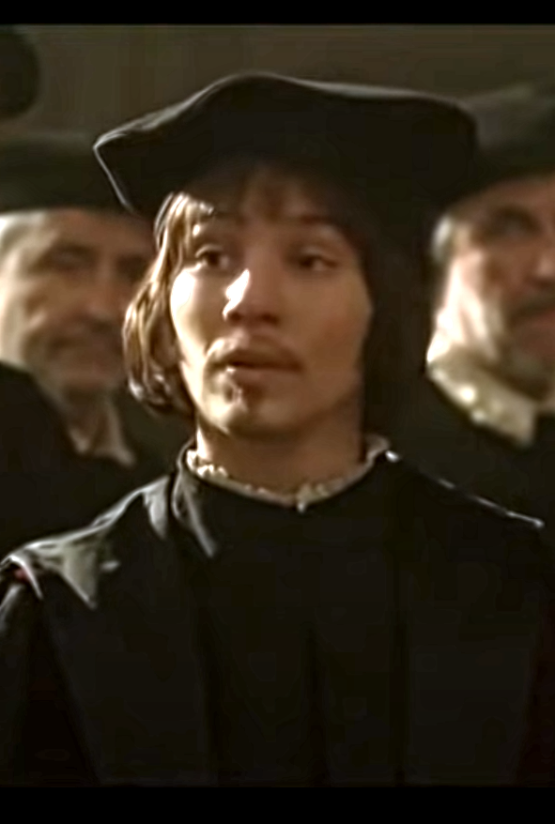
Eight: again about Portia/Balthasar
Portia/Balthasar quotes «the laws of Venice» which states: If it be proved against an alien That by direct or indirect attempts He seek the life of any citizen, The party 'gainst the which he doth contrive Shall seize one half his goods; the other half Comes to the privy coffer of the state; And the offender's life lies in the mercy Of the duke only, 'gainst all other voice. In which predicament, I say, thou stand'st; For it appears, by manifest proceeding, That indirectly and directly too Thou hast contrived against the very life Of the defendant; and thou hast incurr'd The danger formerly by me rehearsed. Down therefore and beg mercy of the duke. (IV, I, 2298-2312)
This is pure invention: -- homicide of any sort was punished in Venice with no distinction of nationality for criminal and victim; -- trials for homicide were held in front of the Council of Forty or the Council of Ten; -- …and we already know how the doge never issued judgments!

Slide 13
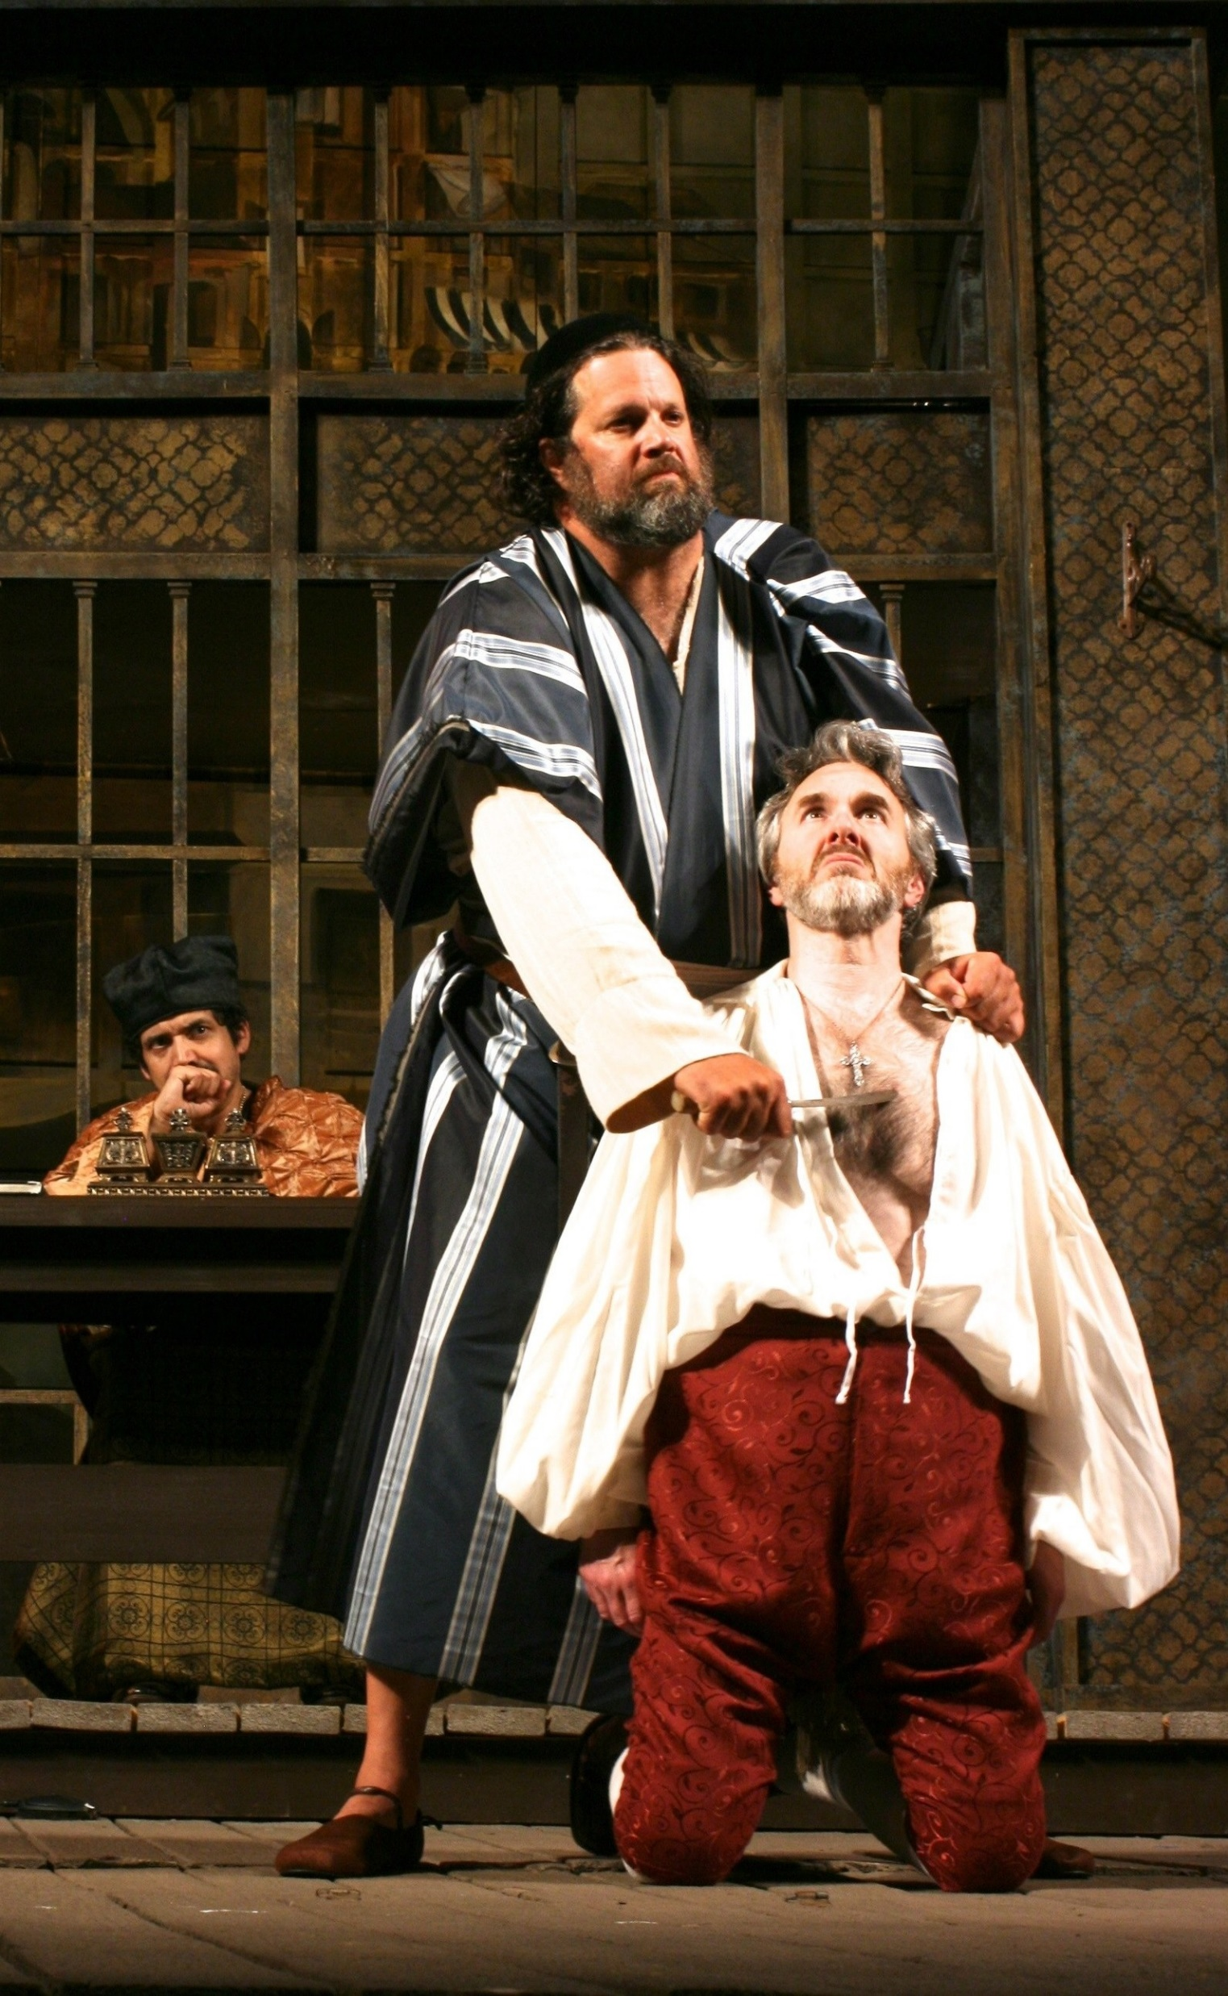
Nine: fanfiction or, what would have been the sentence in real life?
Who has the better claim, Shylock or Antonio? -- the Court correctly upholds the reasons of Shylock, because the Venetian Statutes rule that overdue debts proven by deed must be paid.
What about the penal clause? -- Venetian custom does not allow specific execution, but only by equivalent value: therefore Shylock has no right to a pound of flesh, but only such sum as will cover his damages due to the unfulfilled obligation; -- moreover, Venetian custom reserves to the State the execution of any corporal punishment, so Shylock is forbidden from using his knife.

Slide 14
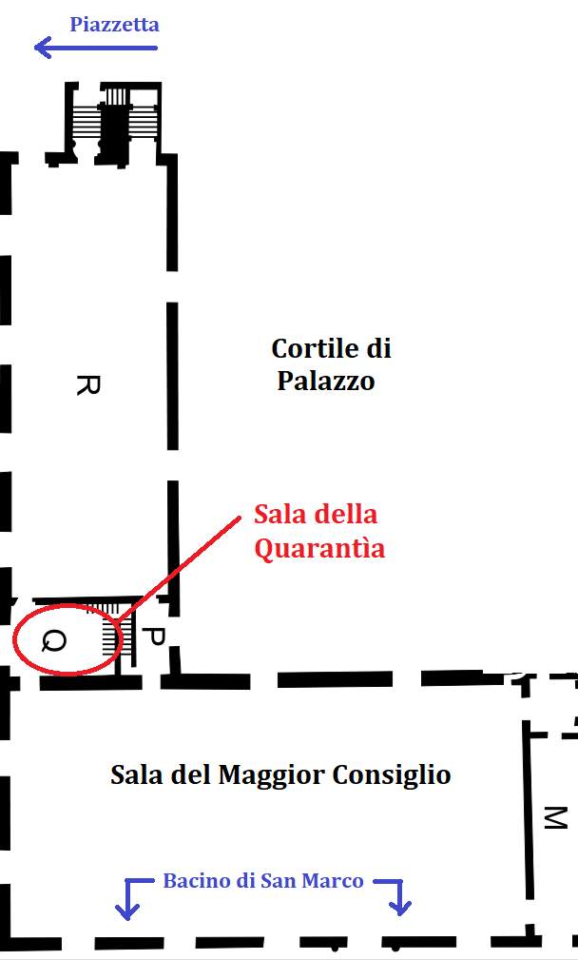
Ten: an alternative ending, less spectacular but true
Antonio is condemned to pay back the loaned capital, plus interests for the delay, plus the Court costs; Bassanio pays in his name..
Antonio is not subjected to the violent penal clause.
Antonio could not be amputated immediately anyway, because a first degree sentence could be appealed against in front of the Council of Forty (Quarantìa Civil Vecchia).
Shylock keeps the whole of his patrimony, and the sentence does not impose any obligation to leave it to his daughter Jessica in his last will.
And Shylock absolutely is *not* compelled to become a Christian!!

Slide 15
Some final thoughts
Is «The Merchant of Venice» tainted with antisemitism?? It is: It sadly reflects the contempt and the discrimination diffused everywhere in Europe, in the middle as well as the modern age and, in the face of everything, often even nowadays.
Shakespeare has no scruple using the Jewish characters in the play in order to rise in the public a feeling of Schadenfreude, the gloating satisfaction in someone else’s mischances.
But Shylock is not just a puppet to be pulled about, but rather a fully fleshed character. Moreover, Shakespeare makes him a brutal mirror for the Christian society in which he lives as some foreign bodydisdained until the time when he becomes useful.
Indeed, the Christian characters do not make such a good impression: Antonio only acts as a gentleman with Christians, Bassanio aims to marry Portia for her money, Lorenzo is guilty of a crime, abducting Jessica (and some of Shylock’s money), Graziano is a debauched good-for-nothing…
Finally, Shylock’s outburst: Se ci offendete, non dovremmo vendicarci? Se siamo uguali a voi per tutto il resto, vogliamo assomigliarvi pure in questo! Resonates more widely than the yesterday’s and sadly today’s antisemitism. It seems to me that it also covers the hate and ostility haunting the post-colonial world.

Slide 16
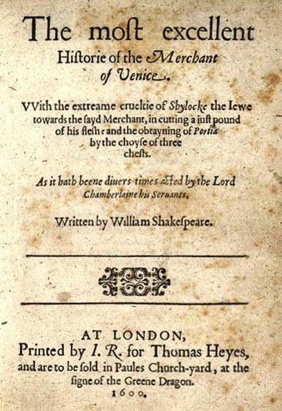
In short…
«The Merchant of Venice» requires from the public (and the readers), or at least those most sensitive to historical context, a huge suspension of disbelief… but definitely the play is worth the effort!

Slide 17
A partial version of this .pptx file was presented at the event:

